Slide 1
Red Black Trees

Slide 2
Attendance Question 1
2000 elements are inserted one at a time into an initially empty binary search tree using the traditional algorithm. What is the maximum possible height of the resulting tree?
1
11
1000
1999
4000
Red Black Trees

Slide 3
Binary Search Trees
Average case and worst case Big O for
  insertion
  deletion
  access
Balance is important. Unbalanced trees give worse than log N times for the basic tree operations
Can balance be guaranteed?
Red Black Trees

Slide 4
Balanced search trees
Balanced search tree: A search-tree data structure for which a height of O(lg n) is guaranteed when implementing a dynamic set of n items.
Examples:
AVL trees
Red-black trees
2-3 trees
2-3-4 trees
B-trees/B⁺-trees
October 19, 2005
Copyright © 2001-5 by Erik D. Demaine and Charles E. Leiserson
L7.2

Slide 5
Red-black trees
This data structure requires an extra one-bit color field in each node.
Red-black properties:
Every node is either red or black.
The root and leaves (NIL’s) are black.
If a node is red, then its parent is black.
All simple paths from any node x to a descendant leaf have the same number of black nodes = black-height(x).
October 19, 2005
Copyright © 2001-5 by Erik D. Demaine and Charles E. Leiserson
L7.3

Slide 6
Red Black Trees
A BST with more complex algorithms to ensure balance
Each node is labeled as Red or Black.
Path: A unique series of links (edges) traverses from the root to each node.
  The number of edges (links) that must be followed is the path length
In Red Black trees paths from the root to elements with 0 or 1 child are of particular interest
Red Black Trees

Slide 7
Paths to Single or Zero Child Nodes
How many?
19
12
35
3
16
21
56
1
Red Black Trees

Slide 8
Red Black Tree Rules
Every node is colored either Red or black
The root is black
If a node is red its children must be black. (a.k.a. the red rule)
Every path from a node to a null link must contain the same number of black nodes (a.k.a. the path rule)
Red Black Trees

Slide 9
Example of a Red Black Tree
The root of a Red Black tree is black
Every other node in the tree follows these rules:
  Rule 3: If a node is Red, all of its children are Black
  Rule 4: The number of Black nodes must be the same in all paths from the root node to null nodes
19
12
35
3
16
21
56
30
Red Black Trees

Slide 10
Red Black Tree?
19
12
35
50
0
75
-10
135
-5
-8
100
-6
80
Red Black Trees

Slide 11
Attendance Question 2
Is the tree on the previous slide a binary search tree? Is it a red black tree?
BST? Red-Black?
No No
No Yes
Yes No
Yes Yes
Red Black Trees

Slide 12
Red Black Tree?
19
12
35
3
16
0
Perfect?
Full?
Complete?
Red Black Trees

Slide 13
Attendance Question 3
Is the tree on the previous slide a binary search tree? Is it a red black tree?
BST? Red-Black?
No No
No Yes
Yes No
Yes Yes
Red Black Trees

Slide 14
Implications of the Rules
If a Red node has any children, it must have two children and they must be Black. (Why?)
If a Black node has only one child that child must be a Red leaf. (Why?)
Due to the rules there are limits on how unbalanced a Red Black tree may become.
  on the previous example may we hang a new node off of the leaf node that contains 0?
Red Black Trees

Slide 15
Properties of Red Black Trees
If a Red Black Tree is complete, with all Black nodes except for Red leaves at the lowest level the height will be minimal, ~log N
To get the max height for N elements there should be as many Red nodes as possible down one path and all other nodes are Black
  This means the max height would be < 2 * log N
  see example on next slide
Red Black Trees

Slide 16
Max Height Red Black Tree
14
12
35
13
21
56
1
43
99
15
25
80
100
70
Red Black Trees

Slide 17
Maintaining the Red Black Properties in a Tree
Insertions
Must maintain rules of Red Black Tree.
New Node always a leaf
  can't be black or we will violate rule 4
  therefore the new leaf must be red
  If parent is black, done (trivial case)
  if parent red, things get interesting because a red leaf with a red parent violates rule 3
Red Black Trees

Slide 18
Insertions with Red Parent - Child
Must modify tree when insertion would result in Red Parent - Child pair using color changes and rotations.
30
15
70
20
60
85
10
80
90
50
65
5
40
55
Red Black Trees

Slide 19
Case 1
Suppose sibling of parent is Black.
  by convention null nodes are black
In the previous tree, true if we are inserting a 3 or an 8.
  What about inserting a 99? Same case?
Let X be the new leaf Node, P be its Red Parent, S the Black sibling and G, P's and S's parent and X's grandparent
  What color is G?
Red Black Trees

Slide 20
Case 1 - The Picture
G
P
S
C
D
E
X
A
B
Relative to G, X could be an inside or outside node.
Outside -> left left or right right moves
Inside -> left right or right left moves
Red Black Trees

Slide 21
Fixing the Problem
G
P
S
C
D
E
X
A
B
If X is an outside node a single rotation between P and G fixes the problem.
A rotation is an exchange of roles between a parent and child node. So P becomes G's parent. Also must recolor P and G.
Red Black Trees

Slide 22
Single Rotation
P
X
G
A
B
C
S
D
E
Apparent rule violation?
Red Black Trees

Slide 23
Case 2
What if X is an inside node relative to G?
  a single rotation will not work
Must perform a double rotation
  rotate X and P
  rotate X and G
G
P
S
A
D
E
X
B
C
Red Black Trees

Slide 24
After Double Rotation
X
P
G
A
B
C
S
D
E
Apparent rule violation?
Red Black Trees

Slide 25
Case 3
Sibling is Red, not Black
G
P
S
D
E
C
X
A
B
Any problems?
Red Black Trees

Slide 26
Fixing Tree when S is Red
Must perform single rotation between parent, P and grandparent, G, and then make appropriate color changes
P
X
G
C
S
A
B
D
E
Red Black Trees

Slide 27
More on Insert
Problem: What if on the previous example G's parent had been red?
Easier to never let Case 3 ever occur!
On the way down the tree, if we see a node X that has 2 Red children, we make X Red and its two children black.
  if recolor the root, recolor it to black
  the number of black nodes on paths below X remains unchanged
  If X's parent was Red then we have introduced 2 consecutive Red nodes.(violation of rule)
  to fix, apply rotations to the tree, same as inserting node
Red Black Trees

Slide 28
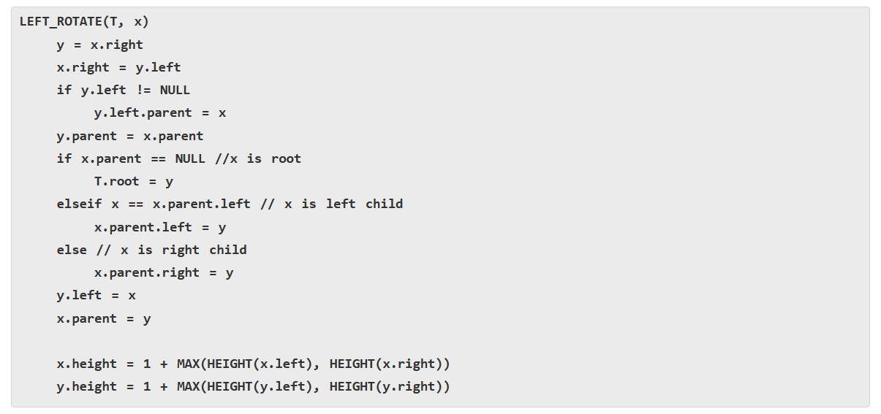
Left Rotation
x
Left-Rotate(T, x)
y
α
Right-Rotate(T, y)
γ
y
x
β
γ
α
β
Red Black Trees

Slide 29
Red Black Trees Insertion
Step 1 - If tree is Empty then insert the newNode as Root node with color Black and exit from the operation.
Step 2 - If tree is not Empty then insert the newNode as leaf node with color Red.
Step 3 - If the parent of newNode is Black then exit from the operation.
Step 4 - If the parent of newNode is Red then check the color of parentnode's sibling of newNode (Uncle’s newNode).
  Step 4.a - If it is colored Black or NULL then make suitable rotation and recolor.
  Step 4.b - If it is colored Red then perform recolor and also check if parent’s parent of newNode (grandparent’s newNode) is not root node then recolor it and recheck (repeat the same until tree becomes Red Black Tree.)
Red Black Trees

Slide 30
Pseudocode
RB-INSERT(T, x) TREE-INSERT(T, x)
color[x] ← RED ⊳ only RB property 3 can be violated
while x ≠ root[T] and color[p[x]] = RED
do if p[x] = left[p[p[x]]
then y ← right[p[p[x]]
if color[y] = RED
then ⟨Case 1⟩
else if x = right[p[x]]
then ⟨Case 2⟩
⊳ y = aunt/uncle of x
⊳ Case 2 falls into Case 3
⟨Case 3⟩
else ⟨“then” clause with “left” and “right” swapped⟩
color[root[T]] ← BLACK
October 19, 2005
Copyright © 2001-5 by Erik D. Demaine and Charles E. Leiserson
L7.24

Slide 31
Graphical notation
Let denote a subtree with a black root.
All ’s have the same black-height.
October 19, 2005
Copyright © 2001-5 by Erik D. Demaine and Charles E. Leiserson
L7.25

Slide 32
Case 1
Recolor
C
C
new x
D
C
C
A
x
y
D
A
B
B
(Or, children of A are swapped.)
Push C’s black onto A and D, and recurse, since C’s parent may be red.
October 19, 2005
Copyright © 2001-5 by Erik D. Demaine and Charles E. Leiserson
L7.26

Slide 33

Case 2
LEFT-ROTATE(A)
C
C_{C}
y
y
A
x
B_{B}
B
x
A_{A}
Transform to Case 3.
October 19, 2005
Copyright © 2001-5 by Erik D. Demaine and Charles E. Leiserson
L7.27

Slide 34
Case 3
RIGHT-ROTATE(C)
y
A_{A}
C
B
B
C
x
A
Done! No more violations of RB property 3 are possible.
October 19, 2005
Copyright © 2001-5 by Erik D. Demaine and Charles E. Leiserson
L7.28

Slide 35
Analysis
Go up the tree performing Case 1, which only recolors nodes.
If Case 2 or Case 3 occurs, perform 1 or 2 rotations, and terminate.
Running time: O(lg n) with O(1) rotations.
RB-DELETE — same asymptotic running time and number of rotations as RB-INSERT.
October 19, 2005
Copyright © 2001-5 by Erik D. Demaine and Charles E. Leiserson
L7.29

Slide 36
Example of Inserting Sorted Numbers
1 2 3 4 5 6 7 8 9 10
Insert 1. A leaf so red. Realize it is root so recolor to black.
1
1
Red Black Trees

Slide 37
Insert 2
make 2 red. Parent is black so done.
1
2
Red Black Trees

Slide 38
Insert 3
1
Insert 3. Parent is red.
Parent's sibling is black (null) 3 is outside relative to grandparent. Rotate parent and grandparent
2
3
2
1
3
Red Black Trees

Slide 39
Insert 4
On way down see 2 with 2 red children.
Recolor 2 red and children black.
Realize 2 is root so color back to black
2
1
3
2
When adding 4 parent is black so done.
1
3
4
Red Black Trees

Slide 40
Insert 5
2
1
3
4
5's parent is red.
Parent's sibling is black (null). 5 is outside relative to grandparent (3) so rotate parent and grandparent then recolor
5
Red Black Trees

Slide 41
Finish insert of 5
2
1
4
3
5
Red Black Trees

Slide 42
Insert 6
2
1
4
On way down see 4 with 2 red
children. Make 4 red and children black. 4's parent is black so no problem.
3
5
Red Black Trees

Slide 43
Finishing insert of 6
6's parent is black so done.
2
1
4
3
5
6
Red Black Trees

Slide 44
Insert 7
2
1
4
3
5
7's parent is red.
Parent's sibling is black (null). 7 is outside relative to grandparent (5) so rotate parent and grandparent then recolor
6
7
Red Black Trees

Slide 45
Finish insert of 7
2
1
4
3
6
5
7
Red Black Trees

Slide 46
Insert 8
2
1
4
3
6
On way down see 6 with 2 red children.
Make 6 red and children black. This
creates a problem because 6’s parent, 4, is also red. Must perform rotation.
5
7
Red Black Trees

Slide 47
Still Inserting 8
2
Recolored now
need to rotate
1
4
3
6
5
7
Red Black Trees

Slide 48
Finish inserting 8
4
Recolored now
need to rotate
2
6
1
3
5
7
8
Red Black Trees

Slide 49
Insert 9
4
2
6
1
3
5
7
8
On way down see 4 has two red children
so recolor 4 red and children black.
Realize 4 is the root so recolor black
9
Red Black Trees

Slide 50
Finish Inserting 9
4
2
6
1
3
5
8
7
9
After rotations and recoloring
Red Black Trees

Slide 51
Insert 10
4
2
6
1
3
5
8
7
9
On way down see 8 has two red children so change 8 to red and children black
10
Red Black Trees

Slide 52
Insert 11
4
2
6
1
3
5
8
7
9
10
Again a rotation is needed.
11
Red Black Trees

Slide 53
Finish inserting 11
4
2
6
1
3
5
8
7
10
9
11
Red Black Trees

